Slide 1
Techniques for Fault Detection and Visualization of Telemetry Dependence Relationships for Root Cause Fault Analysis in Complex Systems
Nathaniel Guy
(With support of Dr. Mehran Mesbahi and Dr. Jeffrey Heer)
Robotics, Aerospace, and Information Networks Lab
University of Washington - William E. Boeing Aeronautics and Astronautics
MSAA Thesis Presentation – March 16th, 2016

Slide 2
Overview
Motivation and Objectives
Model Definition
Fault Detection Background
Correlative Analysis and Visualization Background
Lunar Rover Ground Station Development
Intermediate Testing
2D Embedding Visualizations
Future Work and Conclusion
Acknowledgements
References

Slide 3
Overview
Motivation and Objectives
Model Definition
Fault Detection Background
Correlative Analysis and Visualization Background
Lunar Rover Ground Station Development
Intermediate Testing
2D Embedding Visualizations
Future Work and Conclusion
Acknowledgements
References

Slide 4
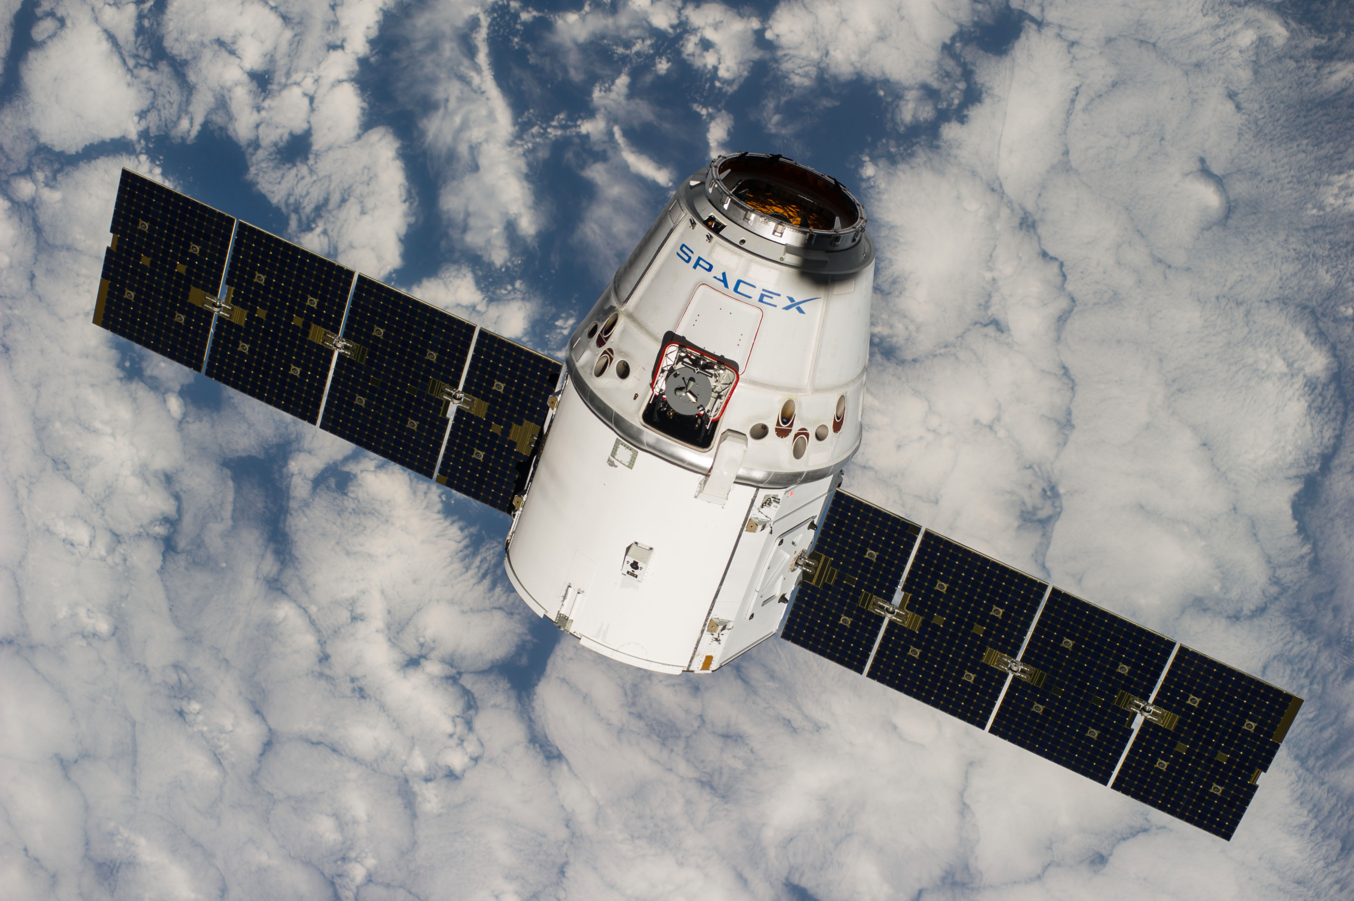
Complex, Remote-Operated Systems
Many types of systems must be teleoperated
Space systems
Underwater ROVs
Robots for radioactive environments
Difficult to troubleshoot
Large amounts of data
Data analysis and visualization becomes difficult
Vehicles such as the Dragon spacecraft have thousands of data channels!

Slide 5
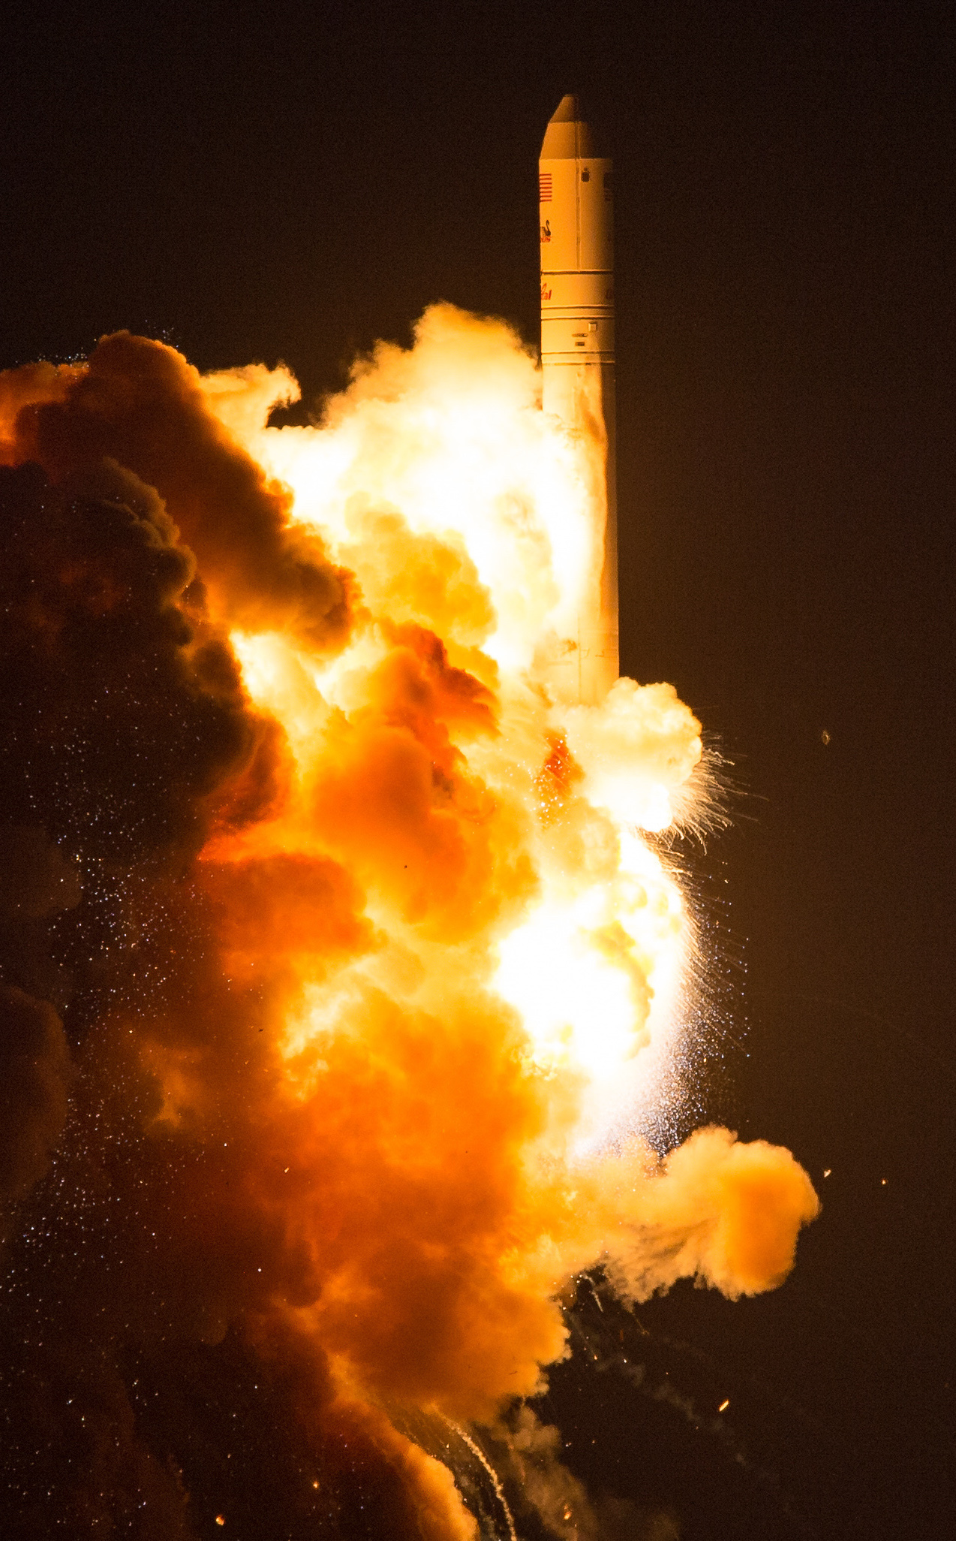
Antares CRS Orb-3
Orbital Sciences October 2014, ISS cargo delivery
Large explosion 6 seconds after launch
Catastrophic failure; cargo completely destroyed
What caused this?
Investigation immediately launched
A week later, problem only vaguely linked to engine (visible in video footage)
Still no conclusive root case given

Slide 6
Root Cause Analysis
Determining root cause for a problem very difficult
Problem detection often doesn’t capture cause
Very human-driven, but tools too simple
Many tools simply consist of plotting data channel time series
Need better analytical tools for linking detected problems to uncaptured causes
Need better human-facing tools to speed up and improve data review

Slide 7
Objectives
Find analytical techniques that can improve root cause analysis
Make user-facing tools to improve human insight into system dynamics
Test above techniques on actual aerospace system data
Create integrated solution that improves root cause analysis

Slide 8
Overview
Motivation and Objectives
Model Definition
Fault Detection Background
Correlative Analysis and Visualization Background
Lunar Rover Ground Station Development
Intermediate Testing
2D Embedding Visualizations
Future Work and Conclusion
Acknowledgements
References

Slide 9
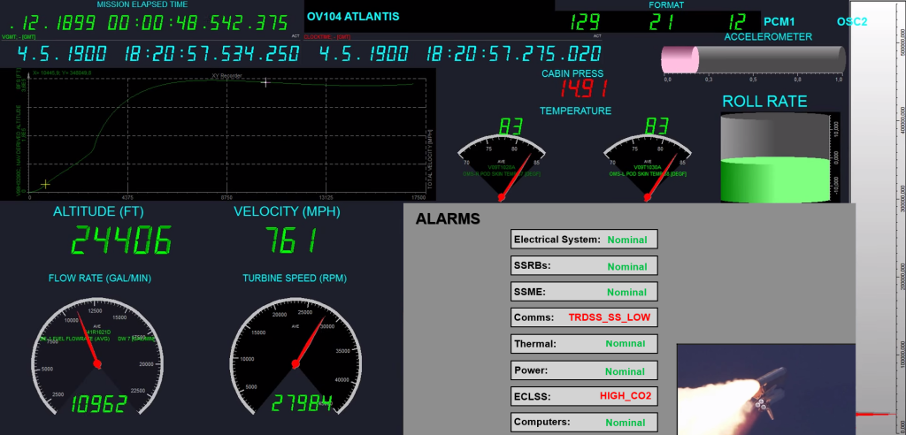
Data Sources
Data streams in discretely from a remote system
This data is “telemetry”
Combination of sensor readings and software metrics
Velocity, acceleration, position, temperature, rotations, attitude, processor usage, dropped packets, etc.
Higher-level telemetry: camera images, spectrograms, etc.
Often thousands of telemetry channels; updates several times per second
Data is received at a “ground station”

Slide 10
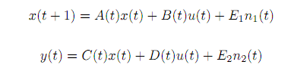
State-Space Model
State modeled discretely:
x(t): system state at time t
y(t): system measurement at time t
u(t): system input at time t
n₁(t) and n₂(t): system disturbance vectors at time t
A(t), B(t), C(t), D(t), E₁(t), E₂(t): linear dynamics
Telemetry data streams in, giving us values for y(t)
Individual elements of y(t) are called telemetry channels

Slide 11
Overview
Motivation and Objectives
Model Definition
Fault Detection Background
Correlative Analysis and Visualization Background
Lunar Rover Ground Station Development
Intermediate Testing
2D Embedding Visualizations
Future Work and Conclusion
Acknowledgements
References

Slide 12
Fault Detection, Isolation, and Recovery (Definitions)
A fault is any system state that is undesirable
FDIR is Fault…
Detection: deciding that a fault occurred
Isolation: determining where the fault occurred
Recovery: restoring the system to a non-faulted state
Normal/expected data is nominal
Otherwise, it’s anomalous
Faults can be divided into fault levels (by severity, or subsystem hierarchy)
Faults can trigger notifications to human operators, called alarms

Slide 13
Alarms

Slide 14
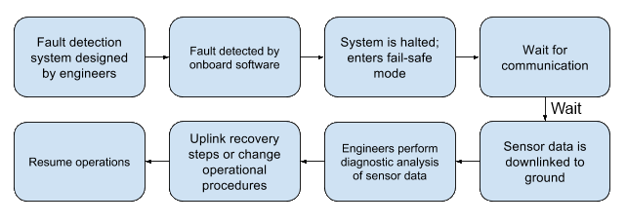
Fault Detection, Isolation, and Recovery (Process)
Many faults cannot be recovered from automatically
Complex issues require human intervention

Slide 15
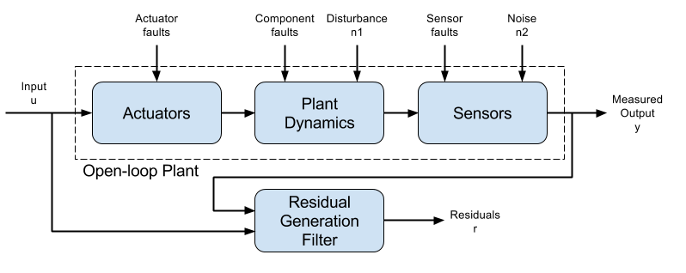
Residual Generation and Fault Detection
Measured output compared to expected system model to find difference
This “residual” used to detect faults
Often, residual simply is a deviation from the expected mean
If residual falls outside a given threshold, a fault may be triggered (e.g., “high acceleration”)

Slide 16
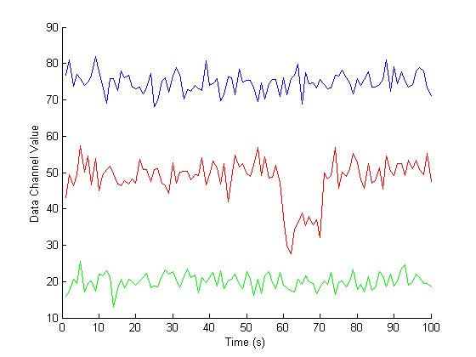
Threshold Fault Detection Example

Slide 17
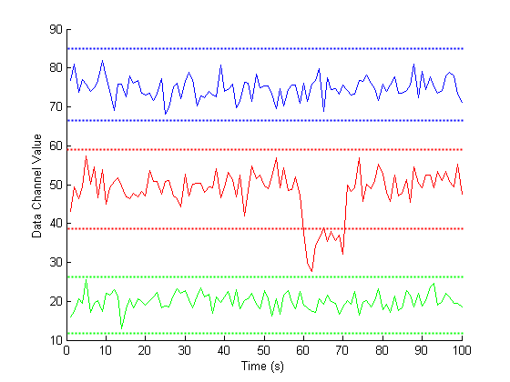
Threshold Fault Detection Example

Slide 18
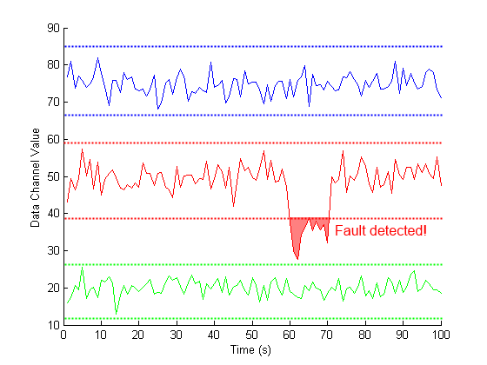
Threshold Fault Detection Example

Slide 19
Other Fault Detection Schemes
Many other types of fault detection
Signal processing
Combinations of complex rules
Probabilistic models
Machine learning from nominal and anomalous data
Redundant hardware systems
We’ll be focusing on models to find deeper root causes which can be agnostic to underlying FD system

Slide 20
Overview
Motivation and Objectives
Model Definition
Fault Detection Background
Correlative Analysis and Visualization Background
Lunar Rover Ground Station Development
Intermediate Testing
2D Embedding Visualizations
Future Work and Conclusion
Acknowledgements
References

Slide 21
Correlative Analysis: Motivation
Traditional FDIR only captures modeled faults
Channels contributing a fault residual may be “linked” to other channels
Channels whose behavior is linked to faulted ones may be related to the fault
Or correlational relationships at the time of a fault may be markedly different from an earlier, non-faulted state, while the raw telemetry is mostly nominal
Example: temperature and wheel rotation
Looking for correlations between channels may be able to find these links
Important to remember that correlation does not necessary imply causation, but can be suggestive

Slide 22

Correlative Analysis: Motivation
Traditional FDIR only captures modeled faults
Channels contributing a fault residual may be “linked” to other channels
Channels whose behavior is linked to faulted ones may be related to the fault
Or correlational relationships at the time of a fault may be markedly different from an earlier, non-faulted state, while the raw telemetry is mostly nominal
Example: temperature and wheel rotation
Looking for correlations between channels may be able to find these links
Important to remember that correlation does not necessary imply causation, but can be suggestive

Slide 23
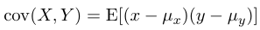
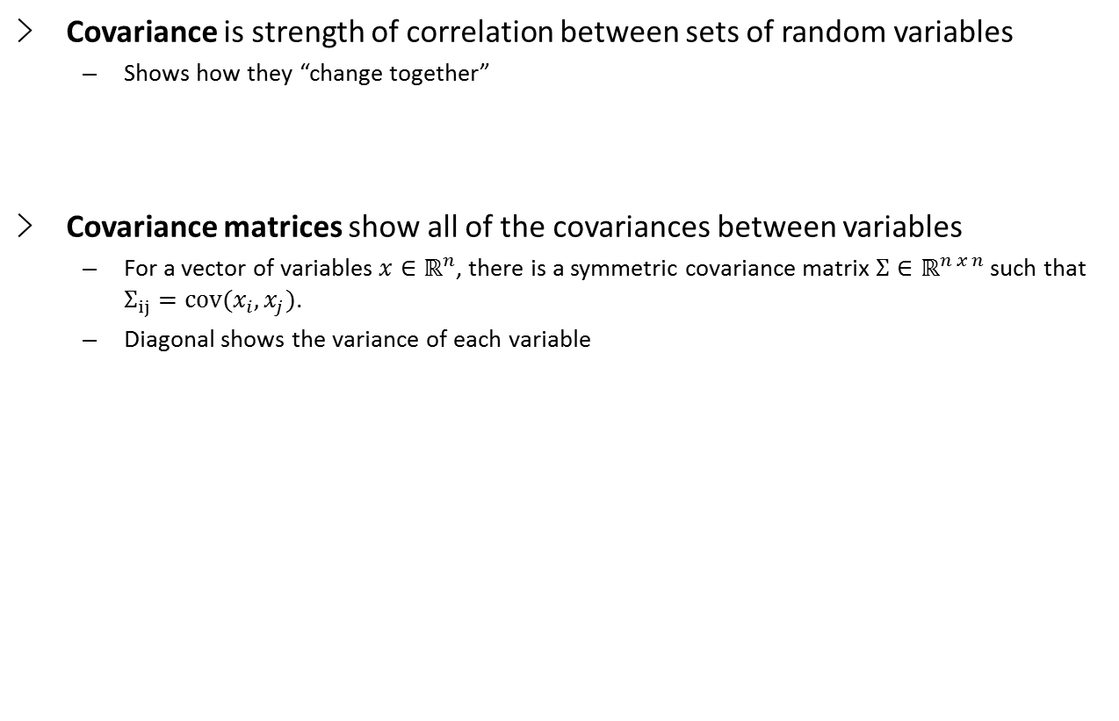
Covariance
Covariance is strength of correlation between sets of random variables
Shows how they “change together”
Covariance matrices show all of the covariances between variables
For a vector of variables $x∈ℝ^{n}$, there is a symmetric covariance matrix $Σ∈ℝ^{n x n}$ such that $Σ_{ij}=cov(x_{i},x_{j})$.
Diagonal shows the variance of each variable

Slide 24
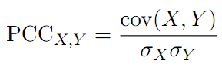
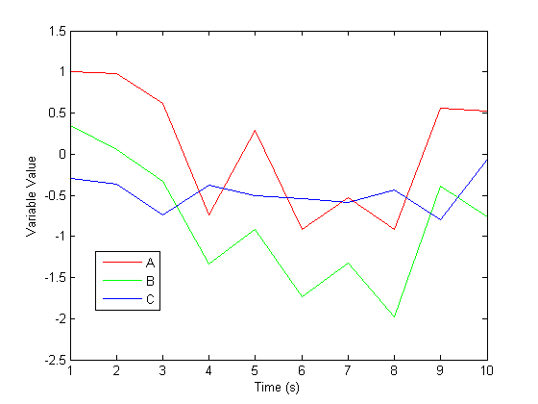
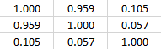
Correlation Metrics: PCC
We can scale a covariance matrix to get a normalized correlation between variables
Most common method is Pearson Correlation Coefficient (PCC):
PCC correlation “score” ranges from 1 (perfect positive correlation) to -1 (perfect negative correlation)
0 indicates no correlation
PCC Correlations
A
B
C
A
B
C

Slide 25
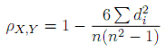
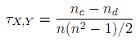
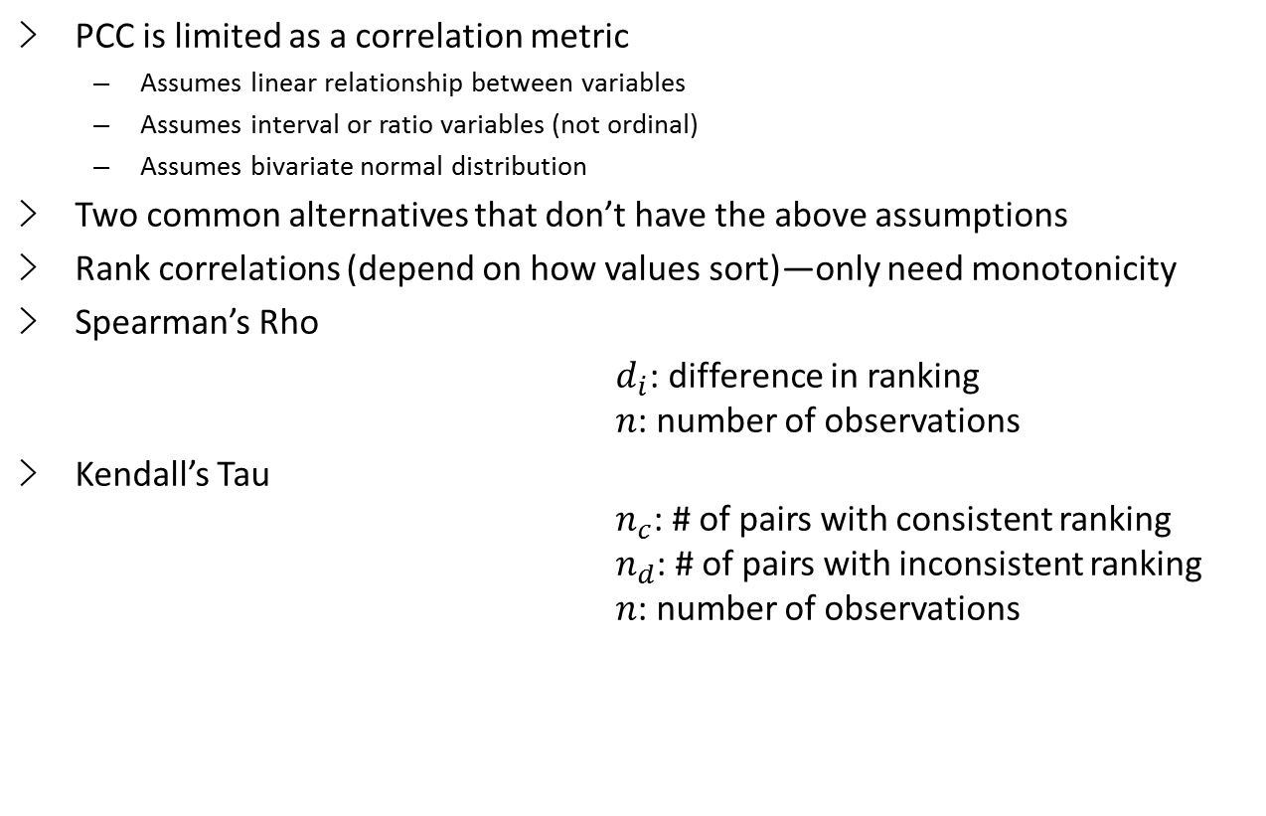
Correlation Metrics: Rho and Tau
PCC is limited as a correlation metric
Assumes linear relationship between variables
Assumes interval or ratio variables (not ordinal)
Assumes bivariate normal distribution
Two common alternatives that don’t have the above assumptions
Rank correlations (depend on how values sort)—only need monotonicity
Spearman’s Rho
$d_{i}$: difference in ranking $n$: number of observations
Kendall’s Tau $n_{c}$: # of pairs with consistent ranking $n_{d}$: # of pairs with inconsistent ranking $n$: number of observations

Slide 26
Static Corrgrams
Correlation matrices often shown as shaded grid (“corrgram”)
Each row is a variable; each column is a variable
Color of cell indicates correlation (usually dark for strong; light for weak)
Non-linear color schemes better map human perception of intensity
High dimensionality of telemetry data pushes the limits of screen space

Slide 27
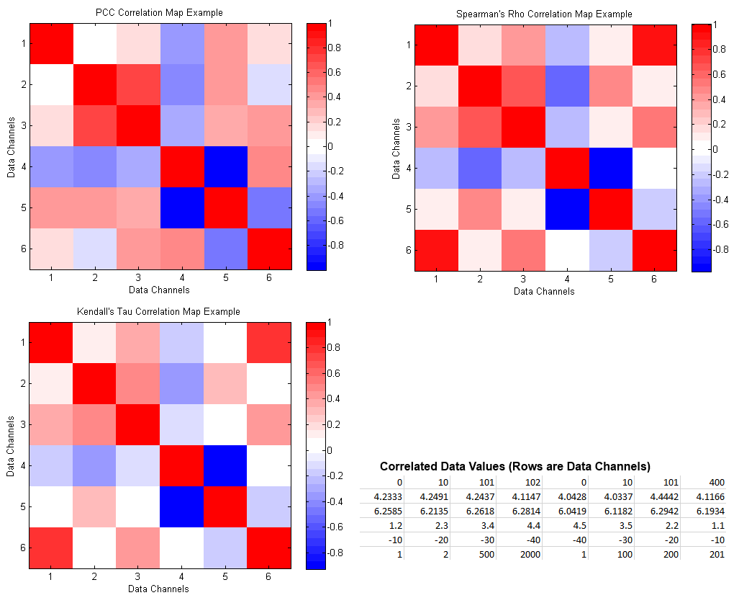
Correlation Metrics: Corrgram Comparison

Slide 28
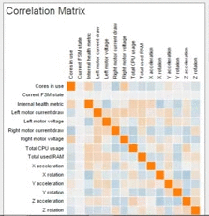

Animated Corrgrams
Corrgrams can only capture data at one point in time
If instantaneous correlation changes over time, we can capture this by sampling a time window
We can then update a corrgram with the latest correlations
Uncommon, but useful

Slide 29
Overview
Motivation and Objectives
Model Definition
Fault Detection Background
Correlative Analysis and Visualization Background
Lunar Rover Ground Station Development
Intermediate Testing
2D Embedding Visualizations
Future Work and Conclusion
Acknowledgements
References

Slide 30
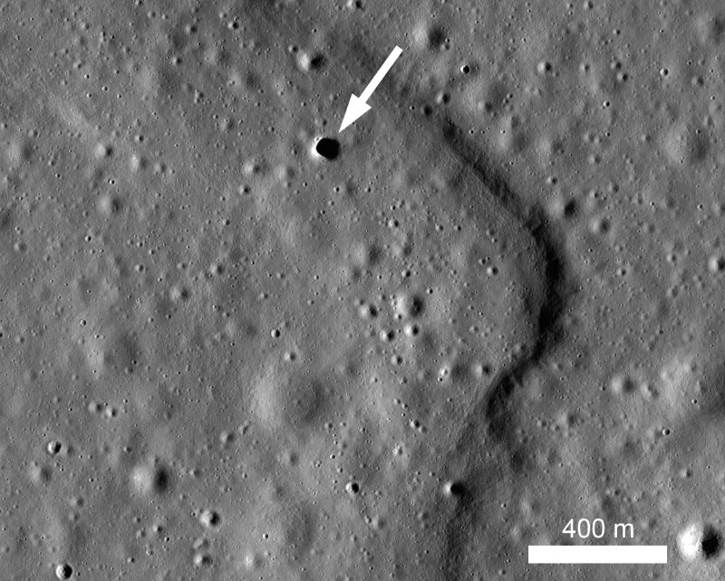

Hakuto and the Google Lunar XPRIZE
Google Lunar XPRIZE competition
Japanese team “Hakuto”
Based at Tohoku University, Sendai, Japan
Mission to the Moon in 2017
Complete GLXP requirements
Explore lunar caves

Slide 31
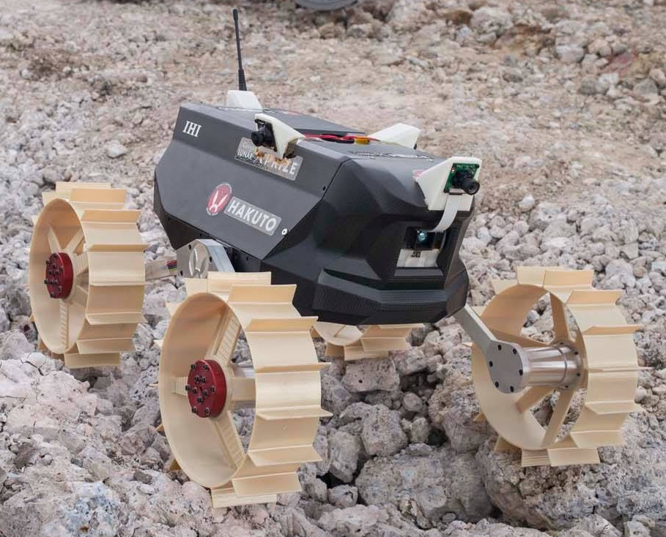
Moonraker Rover
Four-wheeled, 4kg micro-rover
In development since 2010
Four visible-spectrum cameras, 1 depth camera
Many other sensors
~112 telemetry channels
July 2015: Pre-Flight Model 2 development

Slide 32
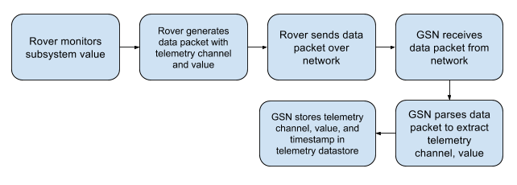
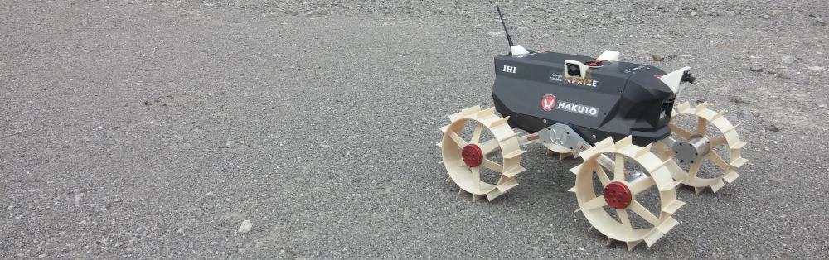
Rover Data Flow

Slide 33
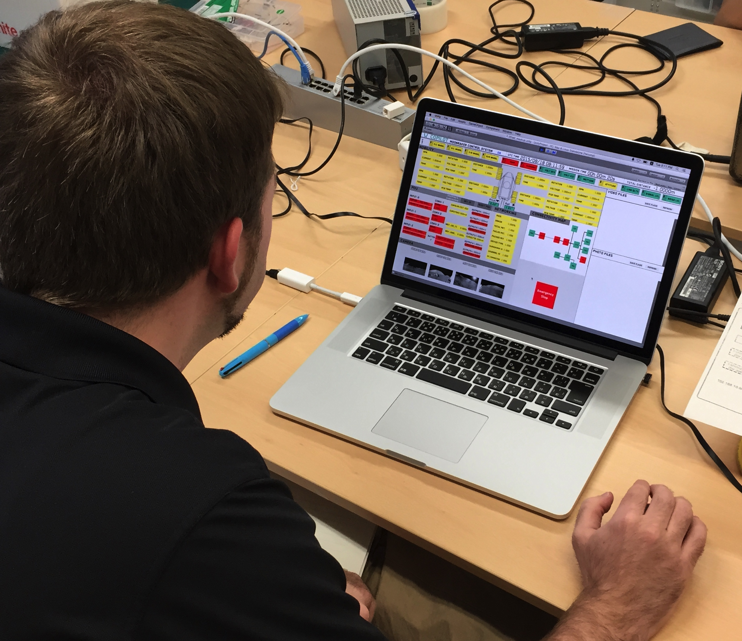
Ground Station Development
Interface for communicating with Moonraker
New system from scratch
Priorities
Easy to understand
Easy commanding
Robust to human error
Maintainable
Unity 3D game engine

Slide 34
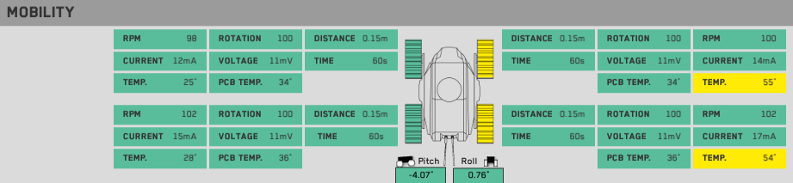
GSN Feature: Telemetry Display
Telemetry displayed on the screen when received from rover
Telemetry grouped by subsystem

Slide 35
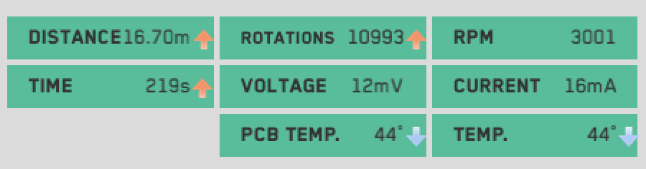
GSN Feature: Telemetry Change Indicators
Telemetry trends shown with arrow-based change indicator system

Slide 36
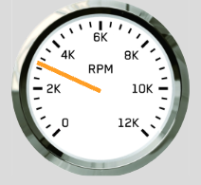
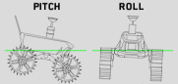
GSN Feature: Tachometer/Attitude Display
Pitch and roll
Calculated from accelerometer telemetry
Shown with 2D rotation of a virtual Moonraker
RPM
Averaged from four-wheel motor telemetry
Shown as an indicator on a virtual tachometer

Slide 37
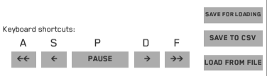
GSN Feature: Saving/Loading/Playback
Incoming telemetry can be paused
Can scrub back and forth through received data
Data can be saved/loaded, or exported to .csv format

Slide 38
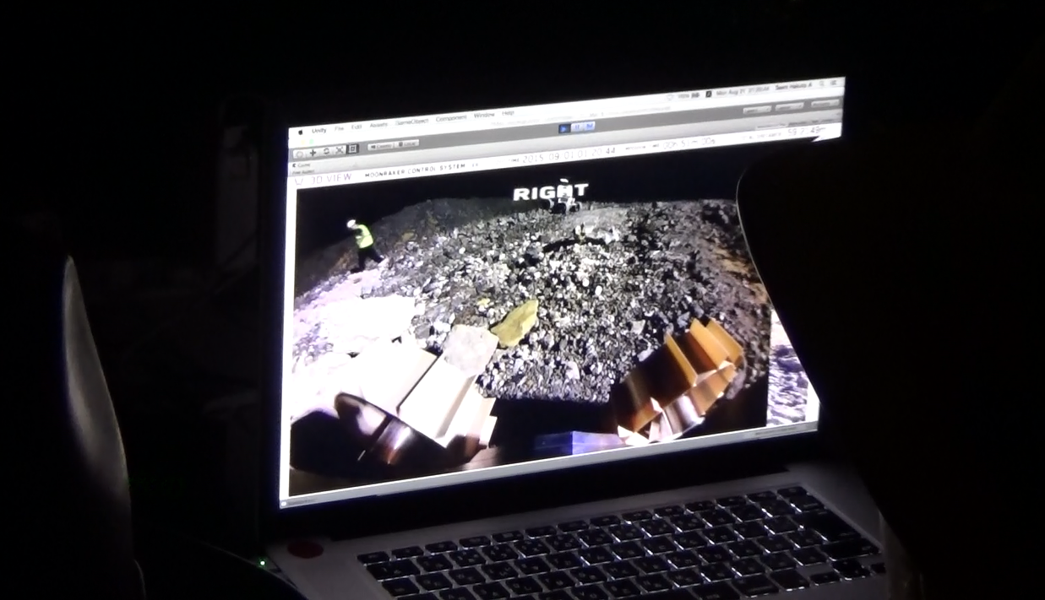
Immersive 3D View
User can rotate a camera inside a virtual 3D room
Each of the four “walls” shows a camera image
Gives intuitive understanding of environment

Slide 39
Threshold-Basic Fault Detection
Telemetry channels are grouped at the top of the screen
Telemetry values exceeding warning/danger thresholds are clearly shown on the screen
Faults in a group trigger its alert panel to change color

Slide 40
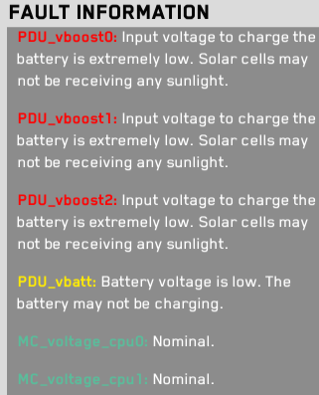
Detailed Fault Information
Fault-specified data shown for selected channels
Detailed descriptions can be provided
Allows for knowledge transfer from experienced operators

Slide 41
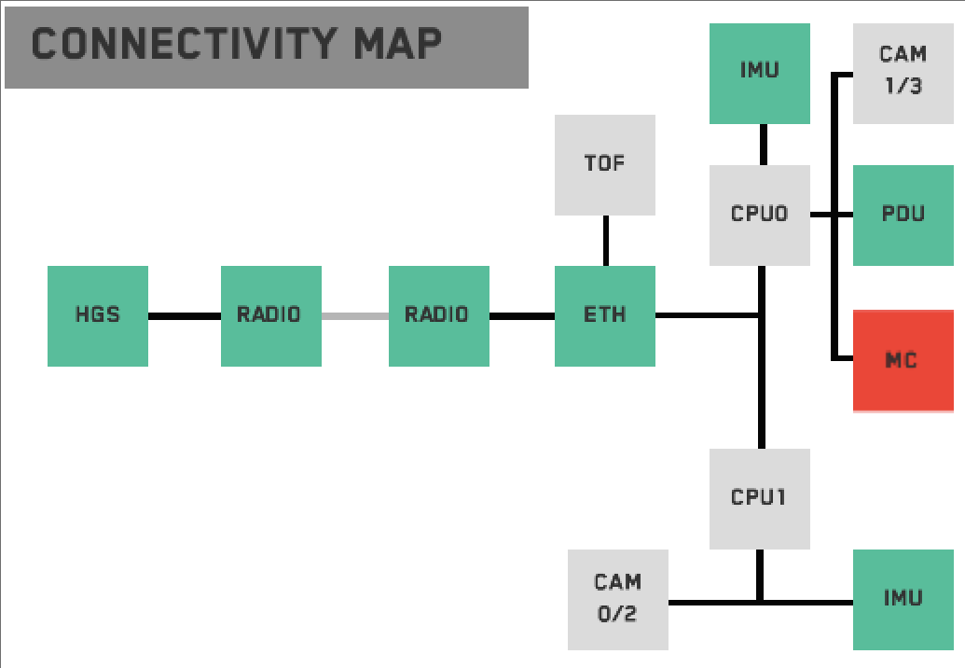
Connectivity Map
Visual display to show current status of modules
Modules change color to reflect how recently they’ve been heard from

Slide 42
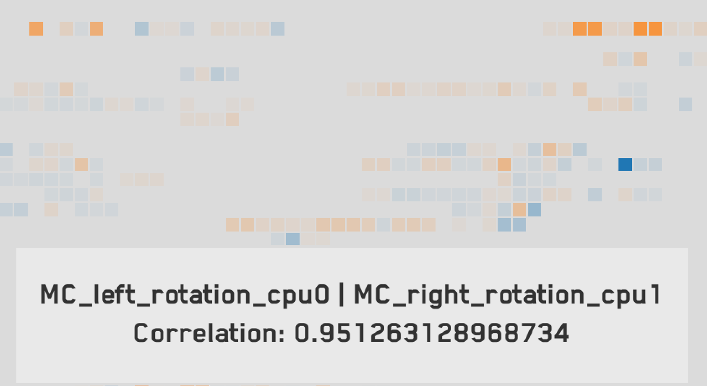
Animated Corrgram
2D grid of blocks
Each block shows the correlation between two channels
PCC correlation score shown as hue:
High positive correlation: orange
High negative correlation: blue
Grid updated with latest correlations

Slide 43
Animated Corrgram Screenshot

Slide 44
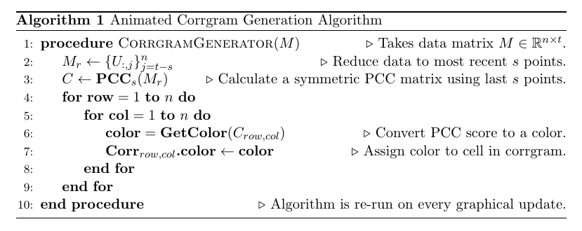
Animated Corrgram Implementation

Slide 45
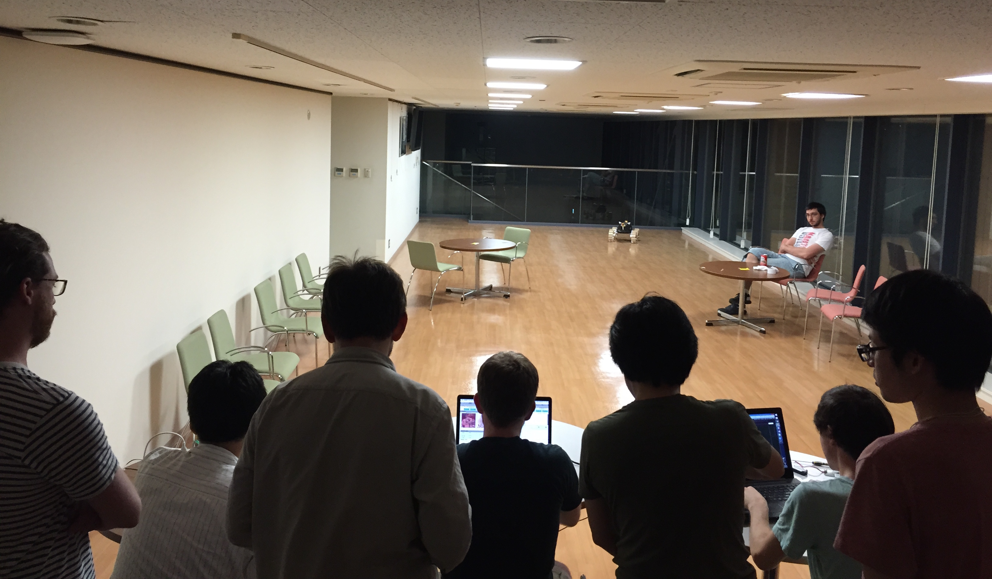
First Integration

Slide 46
Overview
Motivation and Objectives
Model Definition
Fault Detection Background
Correlative Analysis and Visualization Background
Lunar Rover Ground Station Development
Intermediate Testing
2D Embedding Visualizations
Future Work and Conclusion
Acknowledgements
References

Slide 47
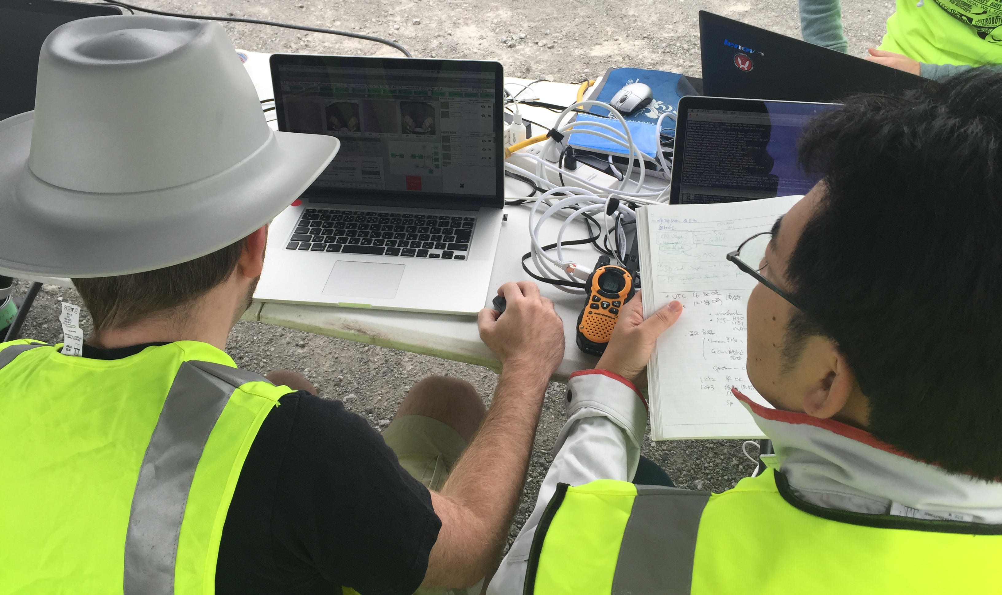
Pittsburgh Field Testing
Six Hakuto engineers went to Pittsburgh in August 2015
Field tests with Hakuto launch partner Astrobotic
Two main goals
V&V of radio comm. system through Astrobotic lander
Mobility and software tests of PFM2 rover
Tested rover on moon-like terrain (rock quarry)
Did tests in lunar lighting-like conditions
Controlled Moonraker from my ground station for all tests

Slide 48
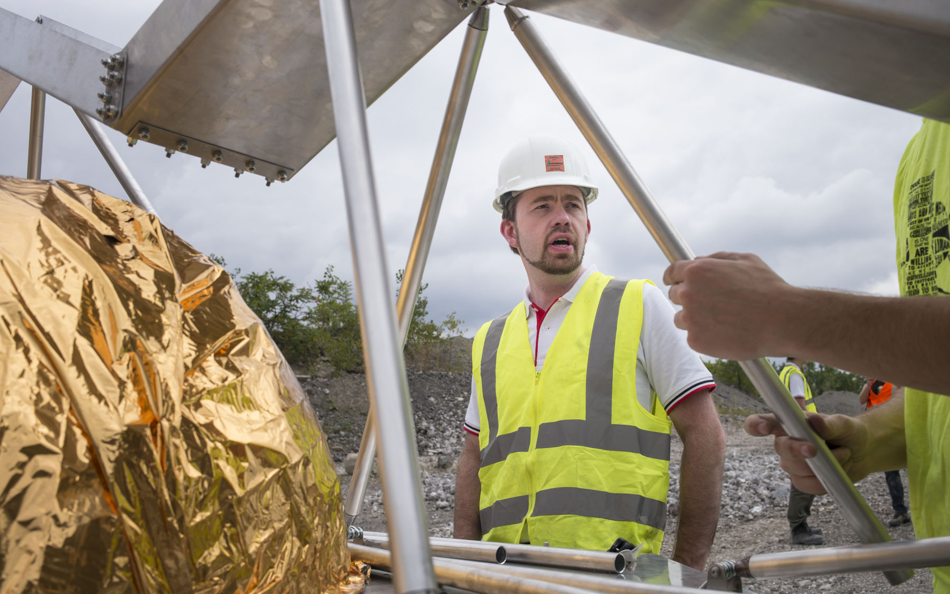
Pittsburgh Field Testing

Slide 49
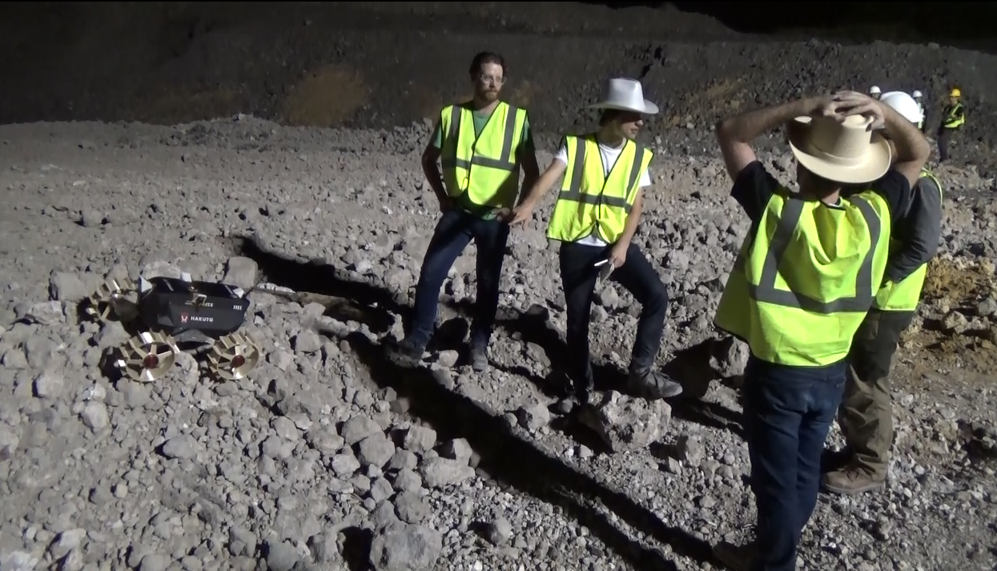
Pittsburgh Field Testing Results
Promising results
Mobility goals successful
Motor controller improvement
Found many software bugs to fix
“Immersive viewing” very useful
“Connectivity map” excellent for troubleshooting
User attention issues

Slide 50
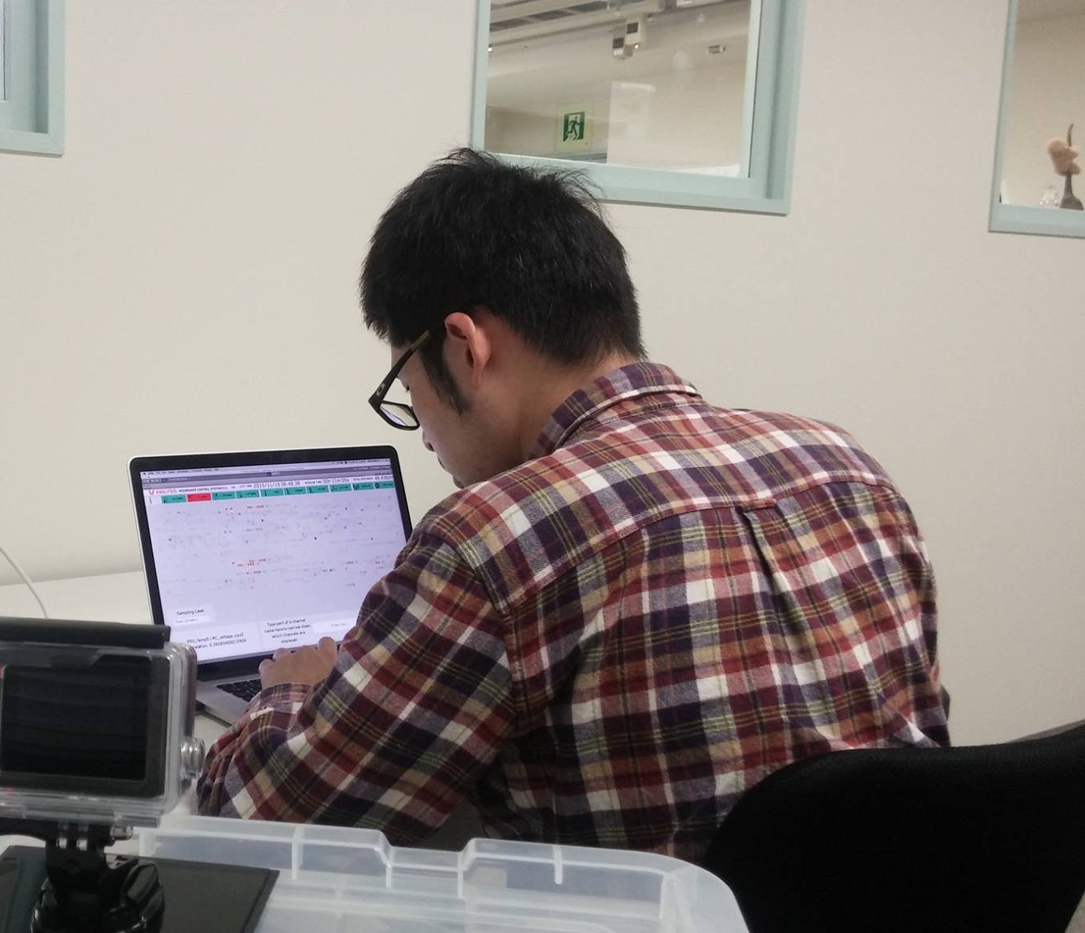
Ground Station Usability Testing Overview
November 2015 testing to find usability issues
Emphasize on data monitoring, analysis
Seven participants
All without extensive GSN experience
10-minute simulated Moonraker lunar run
Each user watched this telemetry and analyzed it
Users told story of what happened

Slide 51
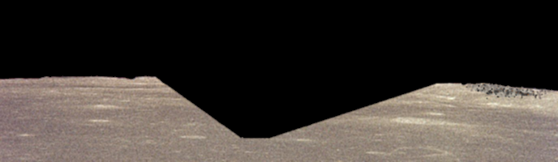
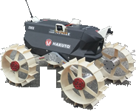
Usability Testing Events
0s: Rover begins traveling forward along smooth terrain.

Slide 52
Usability Testing Events
188s: Rover begins descending into crater.

Slide 53
Usability Testing Events
223s: Rover loses line of sight with lander and packet drops begin.

Slide 54
Usability Testing Events
287s: Rover enters shade, causing temp, comms, and power drops.

Slide 55
Usability Testing Events
300s: Rover begins traversing smooth bottom of crater.

Slide 56
Usability Testing Events
330s: Rover begins climbing out of crater.

Slide 57
Usability Testing Events
343s: Rover exits shade; rover continues uphill.

Slide 58
Usability Testing Events
534s: Rover emerges from crater and enters smooth terrain.

Slide 59
Usability Testing Events
594s: Rover enters choppy terrain.

Slide 60
Usability Testing Events
643s: Rover wheel has fault; rover stops moving.

Slide 61
Usability Testing Results
User intuition matched planned simulation events
Telemetry and fault detection-specific displays very useful
Tunnel vision
More fault descriptions requested
Animated corrgram was hard to use, understand

Slide 62
Testing Takeaways
Ground station extremely useful for standard operations
Needs improvement for root cause analysis to be possible
Not all users are subsystem experts
This knowledge should be captured in ground station UI when possible
Corrgram has too much information to process quickly
Need to reduce information
Corrgram only shows one point in time at a time
Hard to get a clear picture of the timeline by scrubbing back and forth
Need to show everything at once

Slide 63
Overview
Motivation and Objectives
Model Definition
Fault Detection Background
Correlative Analysis and Visualization Background
Lunar Rover Ground Station Development
Intermediate Testing
2D Embedding Visualizations
Future Work and Conclusion
Acknowledgements
References

Slide 64
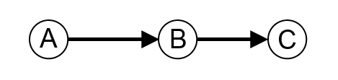
Undirected Correlation Graphs
Start with dependency graph
2D embedding where dependency represented with edge directions
A depends on B; B depends on C:
Variation: undirected graph where edges indicate correlation (each node is a data channel)

Slide 65
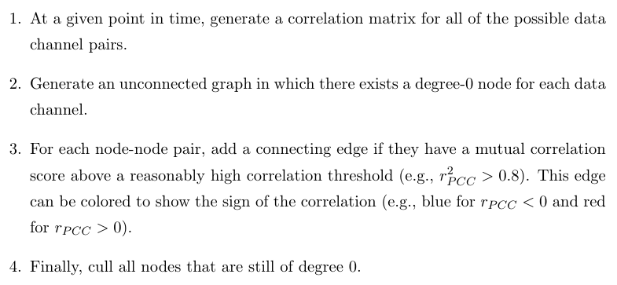
Applying Undirected Correlation Graphs

Slide 66
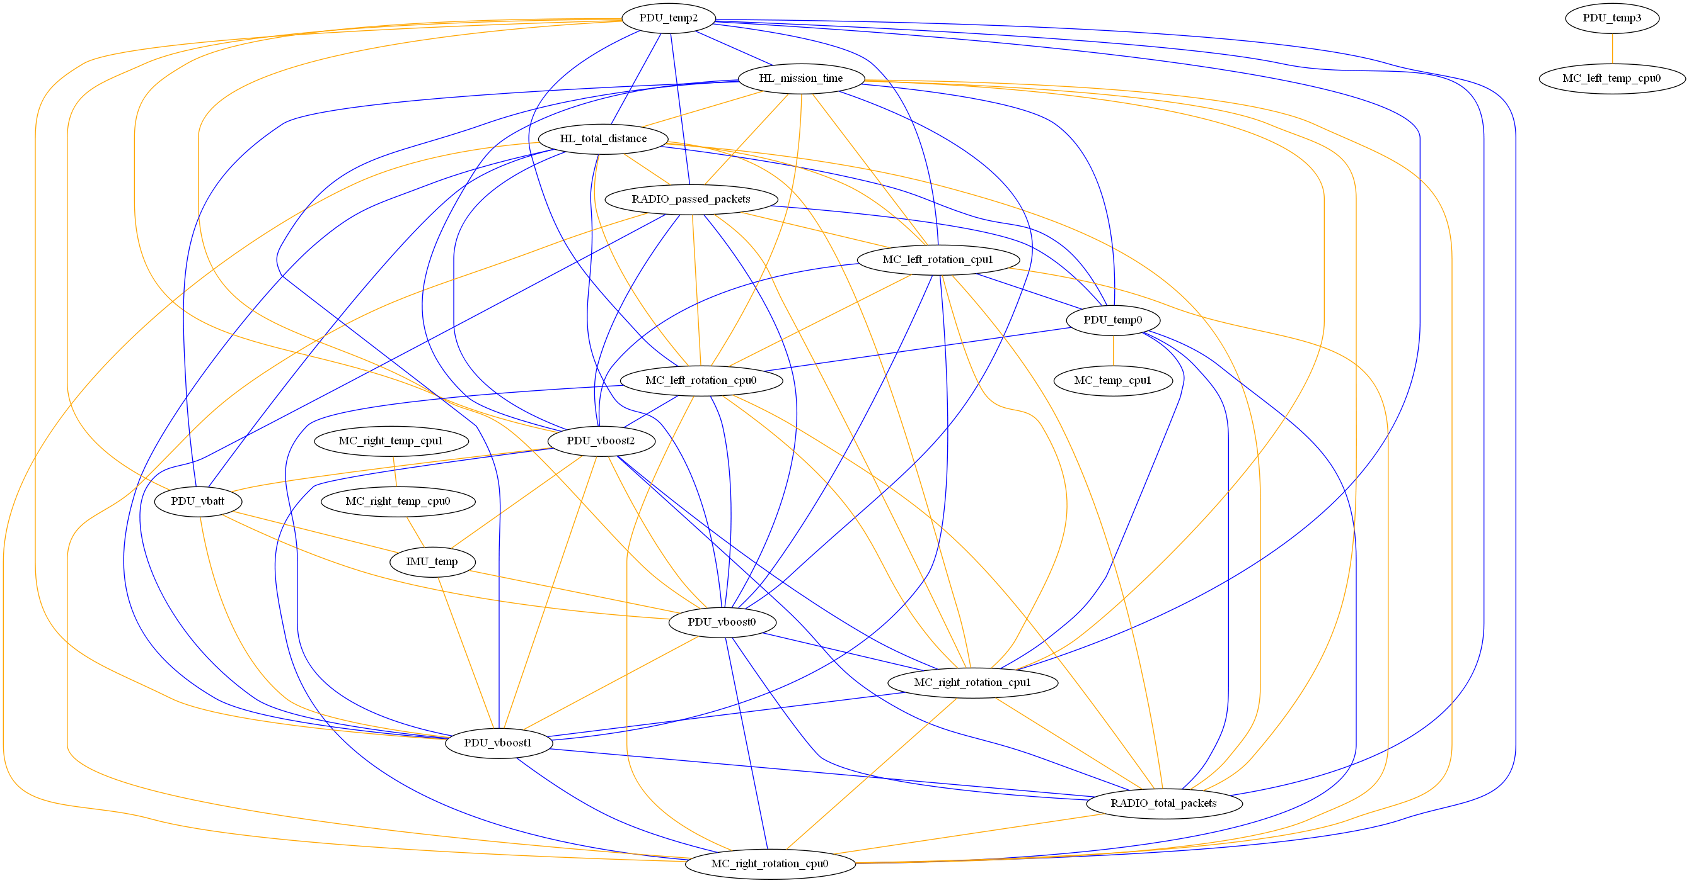
UCGs: Full Correlation

Slide 67
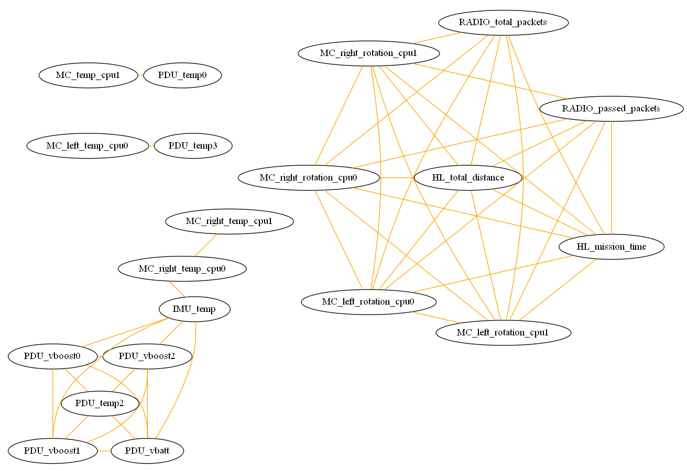
UCGs: Positive Correlations Only

Slide 68
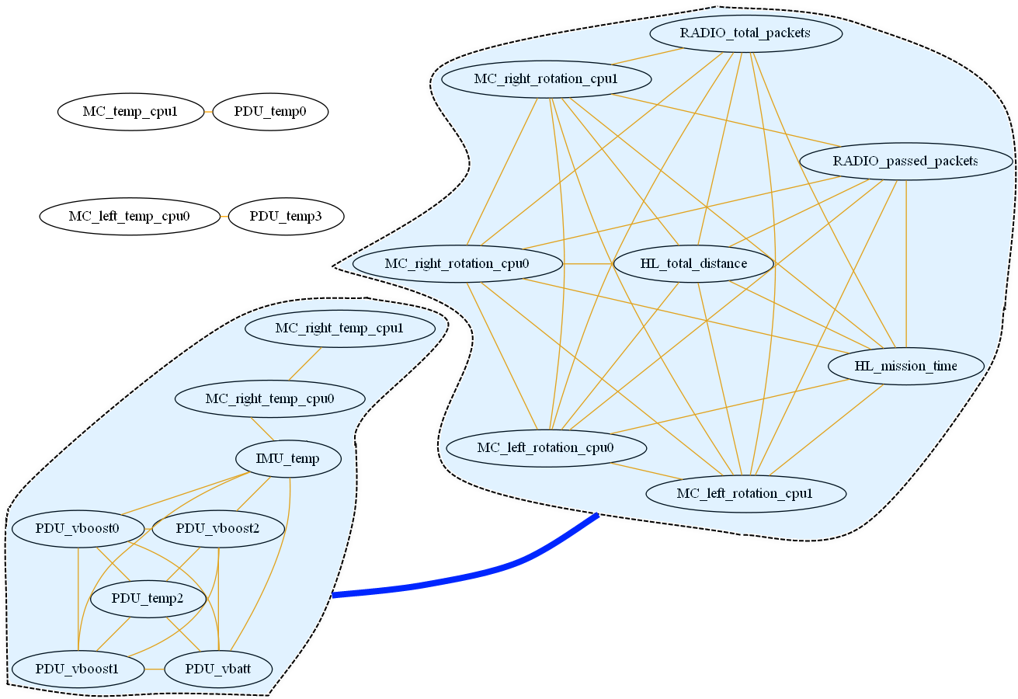
UCGs: Positive Correlations with Cluster Correlations

Slide 69
Observations
Correlations can be understood at a glance
Positive correlations most intuitive
Clustering very useful
Low-degree subgraphs worthy of second look
Doesn’t capture correlative state over time (needs to be animated)

Slide 70
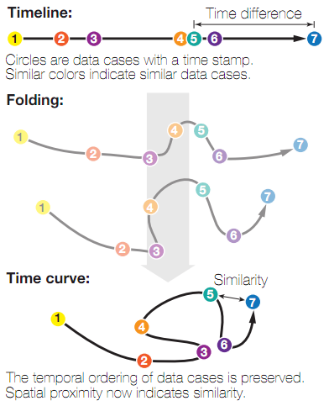
Time Curves
Bach et al. algorithm from 2015
Constructs 2D embedding showing changing system state over time
Uses a set of “time points” and data about their distances to make a graph embedding that shows distance between states while maintaining temporal ordering

Slide 71
Advantages of Time Curves
Show clustering
Visualize cycles
Emphasize transitions
Extensible

Slide 72
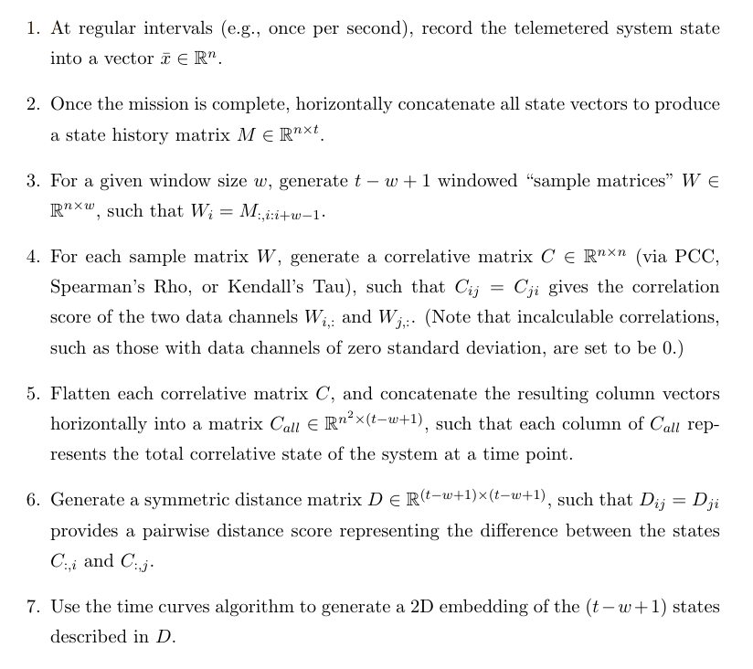
Applying Time Curves

Slide 73
Time Curve Data to Visualize
Used simulated rover data (based closely on real telemetry)
0
1
7
8
9
2
3
6
4
5

Slide 74
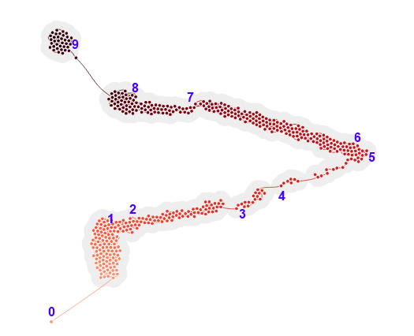
Time Curves on Raw Telemetry State Data

Slide 75
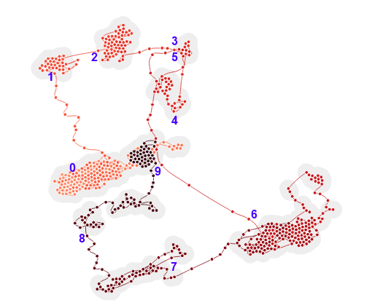
Time Curves on PCC Correlation State

Slide 76

Time Curves on Rho Correlation State

Slide 77

Time Curves on Tau Correlation State

Slide 78
Observations
Operational modes and transitions very clear
Viewer can easily follow state progression
Major moves correspond cleanly to actual timestamps
Correlative analysis progression easier to understand
Monotonicity in raw telemetry
Internal system relationships (rather than environmental ones) more easily captured by correlative analysis
Rank correlative measures better than PCC
May be related to PCC’s assumptions of linearity and continuous variable types
Able to “discover” unique states that aren’t expected (e.g., comms loss in state #2)
Very promising and capable of suggesting correlative changes

Slide 79
Overview
Motivation and Objectives
Model Definition
Fault Detection Background
Correlative Analysis and Visualization Background
Lunar Rover Ground Station Development
Intermediate Testing
2D Embedding Visualizations
Future Work and Conclusion
Acknowledgements
References

Slide 80
Further Work
Integrating visualizations into a cohesive flow
Use data channels at portals between visualizations
Make entire visualization flow automated, real-time
Test on more data sets
Currently talking to University of Michigan, University of Tokyo
Re-test usability with new analytical and visualization features

Slide 81
Conclusion
Built ground station for real aerospace system
Incorporated high-level FDIR troubleshooting
V&V’ed in 100+ hours of field testing and usability testing
Built analytical system to find correlative state
Created three new types of correlative visualizations
Showed that these visualizations give insights that hold up to scrutiny
Tools show promise for future troubleshooting

Slide 82
Overview
Motivation and Objectives
Model Definition
Fault Detection Background
Correlative Analysis and Visualization Background
Lunar Rover Ground Station Development
Intermediate Testing
2D Embedding Visualizations
Future Work and Conclusion
Acknowledgements
References

Slide 83








Acknowledgements

Slide 84
Overview
Motivation and Objectives
Model Definition
Fault Detection Background
Correlative Analysis and Visualization Background
Lunar Rover Ground Station Development
Intermediate Testing
2D Embedding Visualizations
Future Work and Conclusion
Acknowledgements
References

Slide 85
References

Slide 86

Thank you!
Questions?

